Slide 1
Financial News Sentiment App
Andriy Lunin
Muhammad Aziz
Nicholas Raffone
01

Slide 2
To Deliver Financial News and Stock Predictions Efficiently
Our Purpose

Slide 3
Problems
1
2
Information Overexposure There can be hundreds and thousands of news articles relating to a company and it can be quite impossible to read through them all.
Qualitative Sentiments Takes Time Making a judgement call on a company’s stock sentiment is a difficult task as there are a variety of phrases and conditions to look for.

Slide 4

Our Solution
Web Scrape
Go through hundreds of articles to find all the latest and most up to date information on a company
Determine Sentiments
Assign each article a positive or negative correlation and make an overall prediction on the company.
Access Articles and Predictions
Display a link to each article and the sentiment for ease of use and a brief summary before a User visits it.

Slide 5
Market Potential
Many people are looking to find out what stocks to buy/sell
Services are over complicated and require a lot of knowledge to utilize
Services don’t give insight into why they’re making a specific prediction

Slide 6

Our Product

Slide 7
Relevant Articles
Display relevant and recent articles on any company
Up-To-Date Knowledge
Our API scrapes hundreds of articles so our users have the newest information
AI-Based Insights
Display the market’s sentiment towards a given company and articles about it
Actionable Analytics
Make predictions on how the stock will perform based on data

Slide 8
BE AHEAD OF THE CURVE
Receive data-driven suggestions and make choices based on the market
SEARCH FOR A COMPANY
Look up any company you’re interested in through our web application
01
04
02
STAY INFORMED
Read articles and look at the sentiment analysis results to gain a better understanding of the market
03
DIVE INTO THE DATA
Our system look through articles based on your search and analyze their sentiment
Notes:
Add icons and missing title

Slide 9
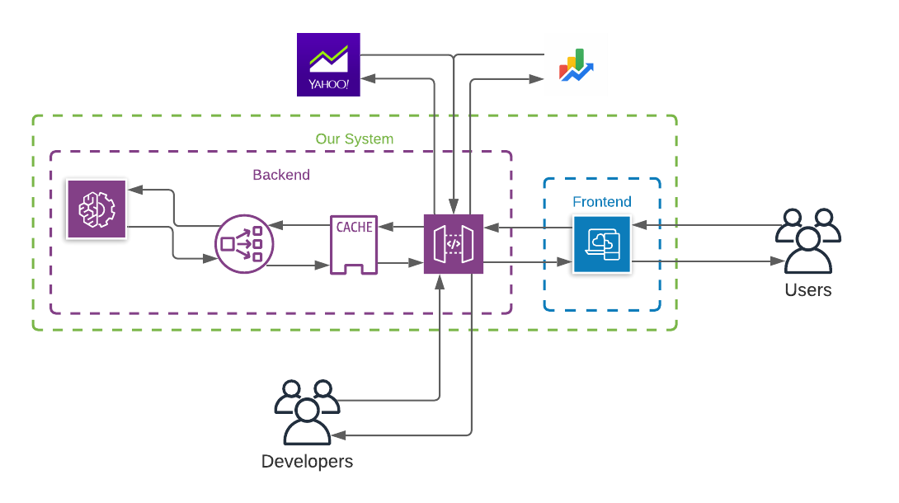
How It Works

Slide 10






Frontend
Backend

Slide 11
Frontend
TypeScript: Strongly typed language that compiles to JavaScript
Tailwind: CSS framework with built-in classes
React: JavaScript library for building user interfaces

Slide 12



Backend
NoSQL Database with a key-value store
Updated per query
TTL default 1 day
AioHTTP multi-threading.
Custom header for avoiding rate limiting
Reduces the news fetch time from 10 minutes to ~10 seconds.
BERT and NLTK for sentiment analysis
Added custom classifier on top of a pre-trained model.
Retrieve continuous [-1,1] classifications based on the sentiment of the article.

Slide 13



Meet The Team
Andriy Lunin
Muhammad Aziz
Nicholas Raffone
Backend, Data, ML
Product, Backend
Frontend, UI/UX
Notes:
Replace these photos and add names (make up positions? lmao)

Slide 14
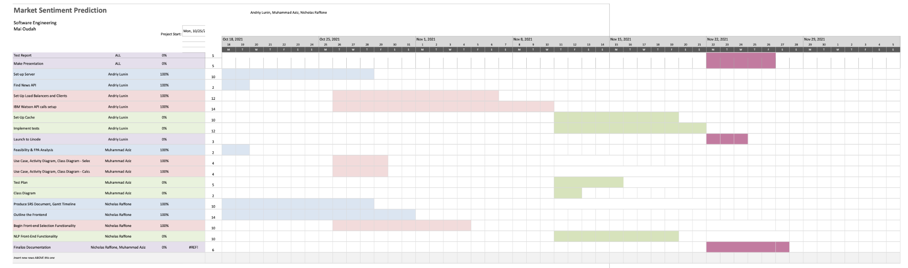
Our Development Process

Slide 15
Moving Forwards
Add a Company Database
Mobile App Development
RSS Development
Notes:
Potential Ideas:
Move to cloud and add a DB
Scrape websites daily
Add a Stock Calculator for accurate predictions?
Gain access to better finance apis
Mobile App Development
Just find ways to make data more accessible

Slide 16
Thank you!
Don’t buy crypto!

